Slide 1
Meeting Outline
Current status of the project
  Moved to closed-loop training
Asked for extension of 4 weeks
  Got accepted yesterday new deadline 25 oktober
Refresh system and augmentation implementation
Goal of this meeting:
  Augmented states not learning
    ANN correction to physical states works
Questions

Slide 2

Baseline model

Slide 3

System for data generation

Slide 4

Augmentation
Overview
Notes:
Kijken gaug is dat augmented states?

Slide 5
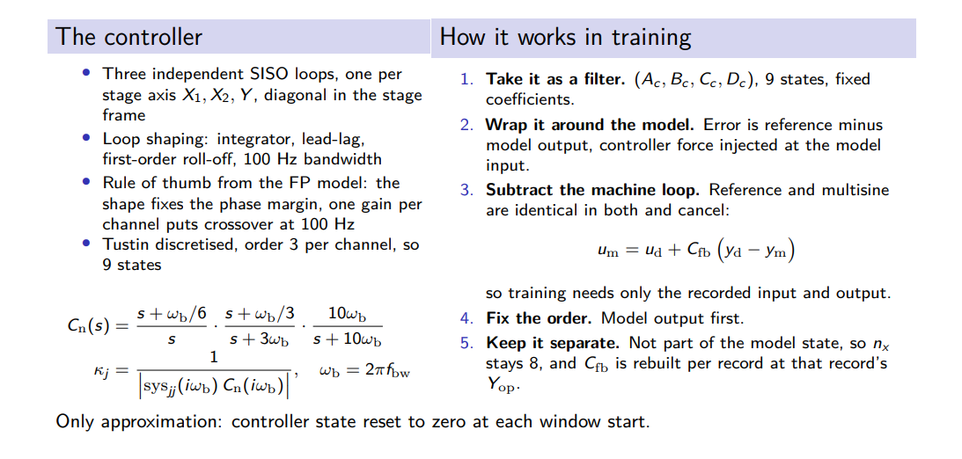
Closing the loop in training
Notes:
It is the discrete controller $\Cfb(z)$ written as a recursion instead of a transfer function.$$x_{c,k+1} = A_c x_{c,k} + B_c e_{c,k}, \qquad \ufb{}{,k} = C_c x{c,k} + D_c e_{c,k}$$

Slide 6
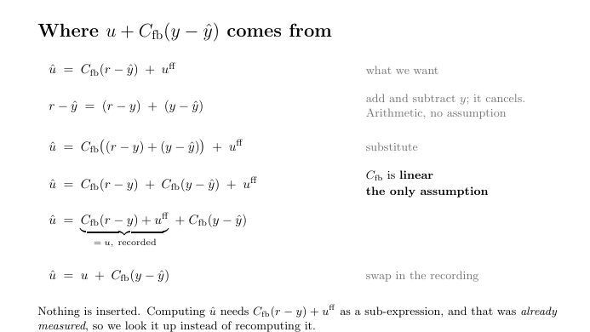

Slide 7
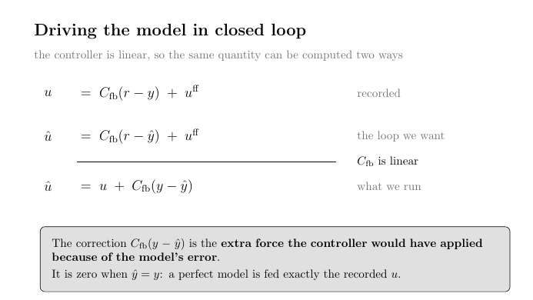
Notes:
One signal, three uses:
e[k] = y_data[k] − y_model[k]
│
├─ fed to Cfb inside the rollout → correction Cfb(e) added to the plant input
├─ squared and averaged over the window → training loss (MSE, normalised)
└─ squared and averaged over a whole record, in metres → validation score (RMS)

Slide 8
Controller function in Matlab
function C = ruleOfThumb(fbw, sys, ts)
s = tf('s');
int_factor = 1/6;
int = (s+2*pi*fbw*int_factor)/s;
leadlag_factor = [1/3, 3];
leadlag = (s+2*pi*fbw*leadlag_factor(1))/(s+2*pi*fbw*leadlag_factor(2));
lowpass_factor = 10;
lowpass = 2*pi*lowpass_factor*fbw/(s+2*pi*lowpass_factor*fbw);
Cnorm = int*leadlag*lowpass;
K = 1/abs(freqresp(sys*Cnorm, 2*pi*fbw));
C = K*Cnorm;
C = c2d(C, ts, 'tustin');
end

Slide 9
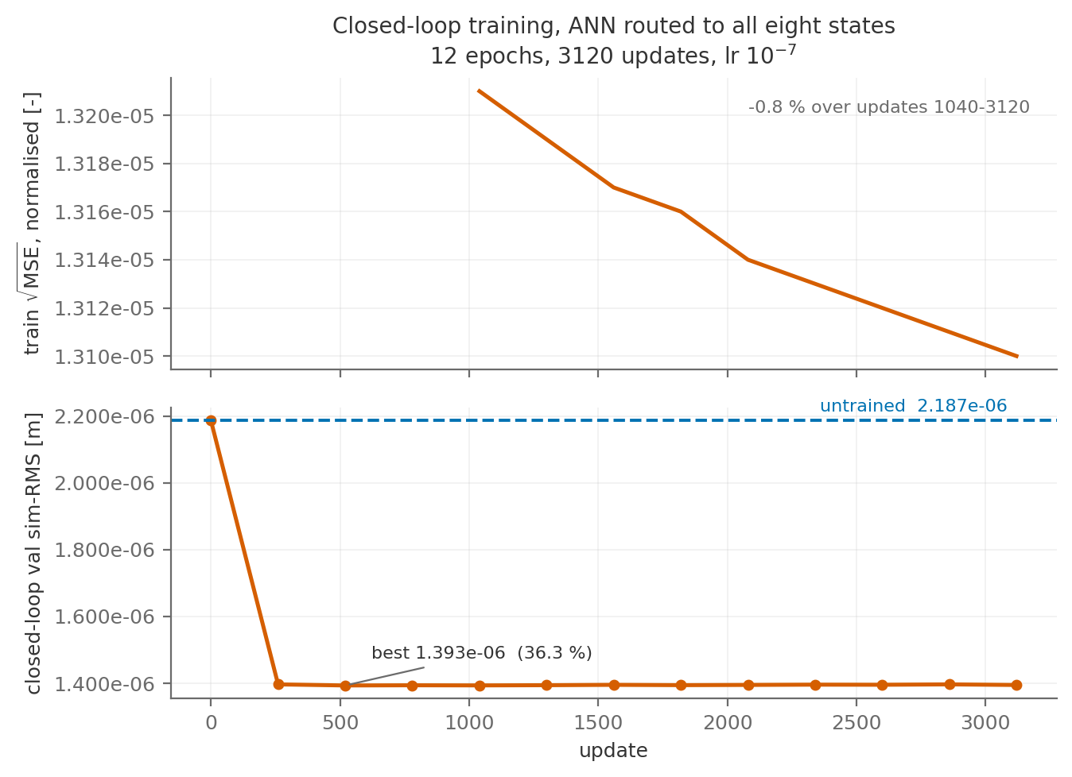

Slide 10
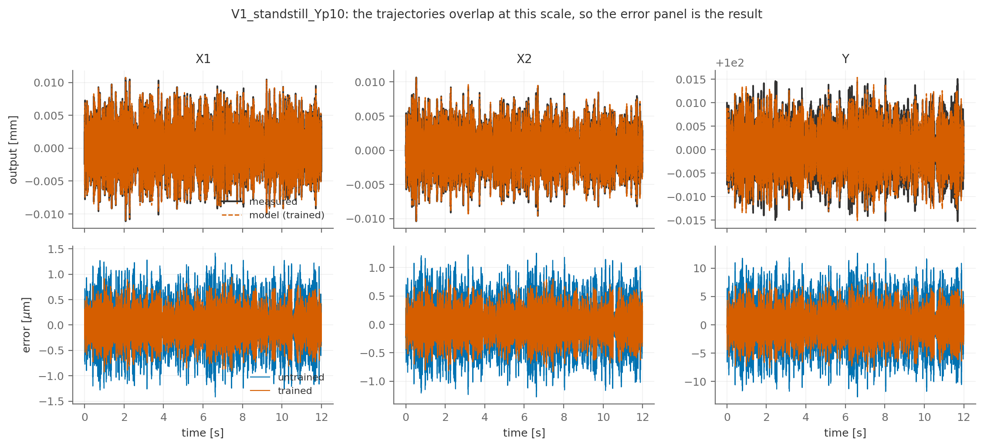

Slide 11
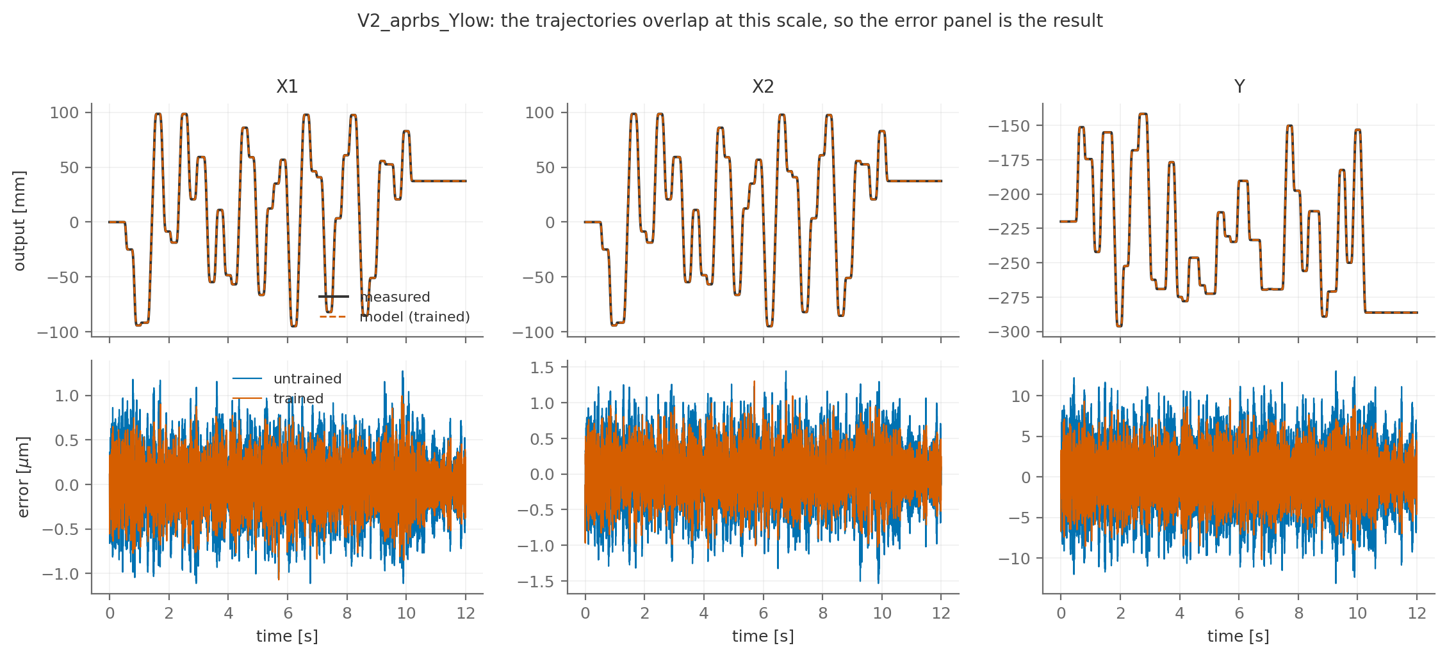

Slide 12
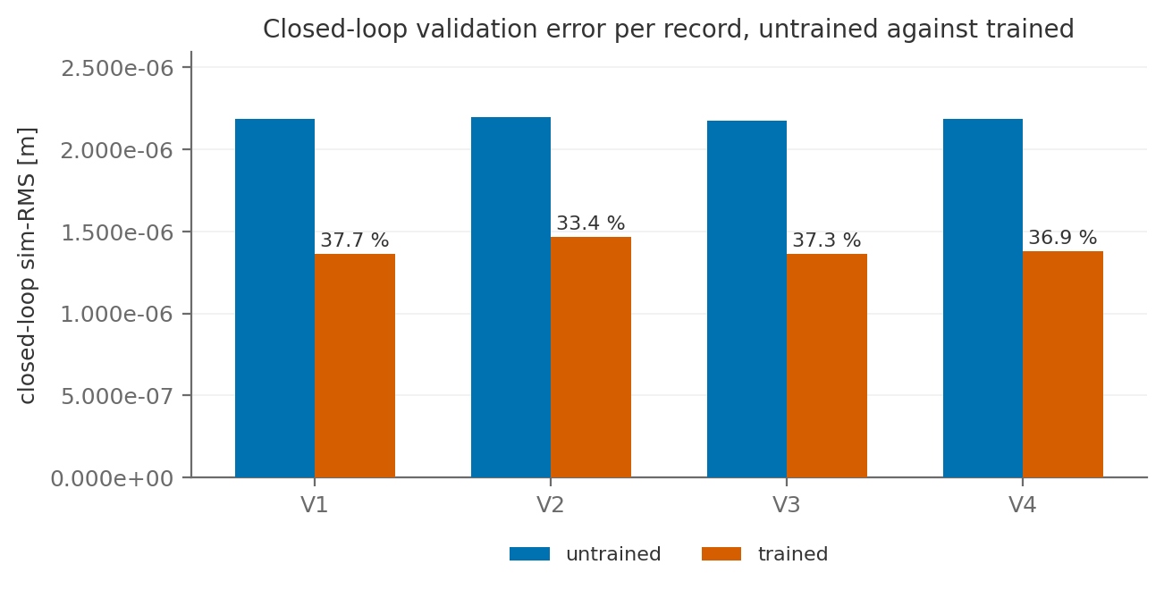

Slide 13

Model = System

Slide 14
Still room for the training of the additional states to improve
Increasing training window from 0.1 s to 0.2 s or 0.3 s found the same optimum within the same optimization window
Model = System

Slide 15
Training capped at 36% improvement
Why?

Slide 16
Augmented states not learning
Only the ANN correction to the physical states caused the 36% improvement.
The augmented states didn’t improve: no incentive to learn

Slide 17
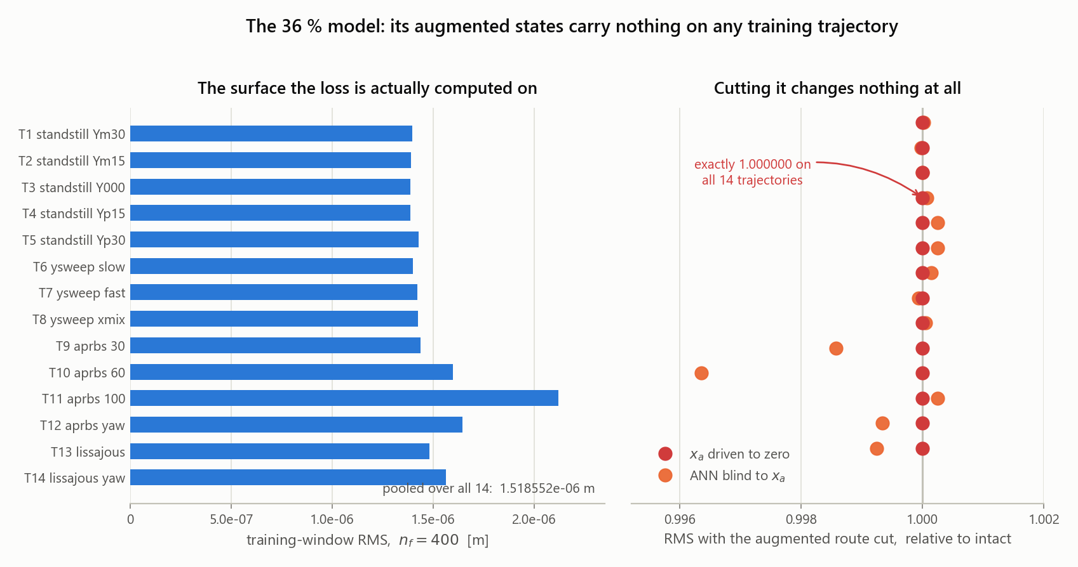

Slide 18
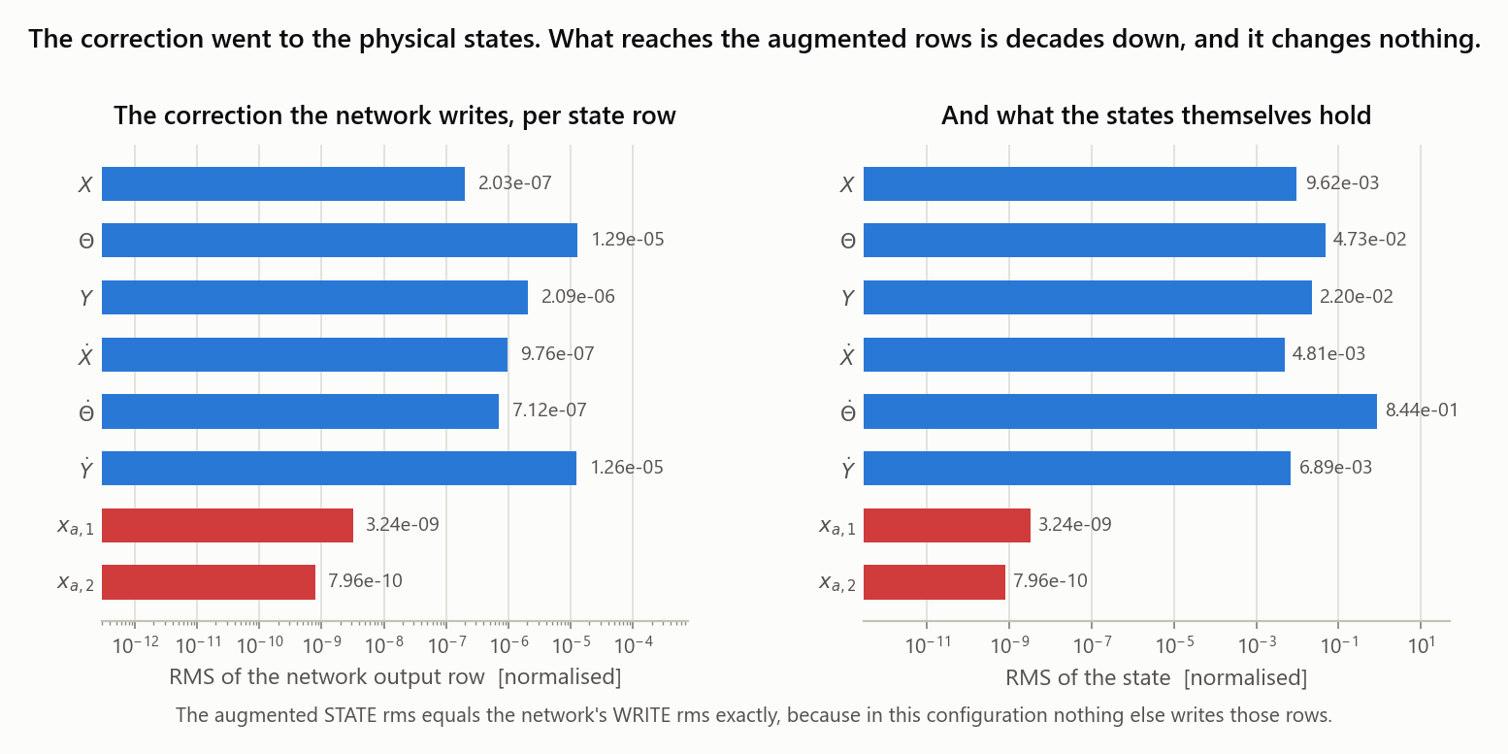

Slide 19
Augmented states not learning
Not enough gradient?

Slide 20
Augmentation
Identified linear dynamics
Not a clean implementation
  But might give insight in how to fix the current training issues
  Similar to full-black box approach with initialization
Current mismatch between system and model is linear
  Not sure how much this implementation takes away from learning nonlinearities
  Could add cubic spring to the system to verify this part

Slide 21
Identify poles of the residual
System - Baseline model
Training record
measured u(k), y(k)
│
▼
Baseline closed-loop replay
│
▼
Residual
r(k) = y(k) − yb(k)
│
▼
Fit linear residual model
and extract its complex poles
│
▼
Identified pole used for A_aa
Notes:
Shared-denominator multivariable ARX model from \(u(k)\) to \(r(k)\).

Slide 22
Identify poles of the residual
System - Baseline model
Property | Actual system pole | Identified pole | Difference | Relative difference
Damped frequency [Hz] | 1.581139e+2 | 1.578937e+2 | -2.202000e-1 | -1.392671e-3
Damping ratio [-] | 5.000000e-2 | 5.275827e-2 | +2.758270e-3 | +5.516540e-2
Notes:
Shared-denominator multivariable ARX model from \(u(k)\) to \(r(k)\).

Slide 23
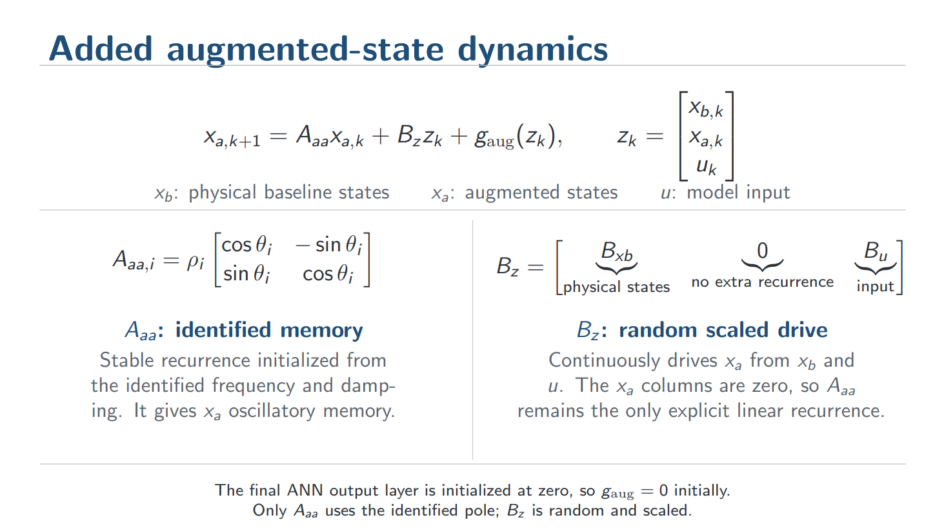
Notes:
Random (draw_input_map, line 349): entries drawn i.i.d. U(-1, 1) from a dedicated torch.Generator seed (so the draw is reproducible and does not disturb the global RNG stream / batch order). The x_a columns are then hard-zeroed as a structural invariant, so A_aa stays the only explicit linear recurrence.
$B_z$ is an $n_a \times n_z$ matrix that maps $z_k = [x_{b,k};,x_{a,k};,u_k]$ into one scalar drive per augmented state, $d_k = B_z z_k$, with the $x_a$ columns held at zero so it only mixes physical states and input. That drive enters the update $x_{a,k+1} = A_{aa}x_{a,k} + d_k + g_{\mathrm{aug}}(z_k)$, so $B_z$ sets which combination of measured signals excites each oscillator and $A_{aa}$ sets the frequency and damping with which that excitation is retained.
$B_z$ is a mixing matrix: each of its rows takes a weighted combination of the physical states and the input, producing one drive signal per augmented state. At every sample that drive strikes the oscillators defined by $A_{aa}$, so $B_z$ decides what the augmented states listen to while $A_{aa}$ decides what they remember.
You have a vector $z_k$ that stacks everything the block can see at time $k$: the physical baseline states, the current augmented states, and the input.
That single scalar is what gets pushed into state 3 at that time step. $B_z$ answers one question, and only one: which weighted combination of the physical states and input does each augmented state listen to?
The one-line version: $A_{aa}$ decides what the extra states remember; $B_z$ decides what they are listening to; the ANN decides what to do with the result. Only the first is identified from data. The second is a generic random guess that training refines.

Slide 24
Augmentation
Overview
Notes:
Kijken gaug is dat augmented states?

Slide 25
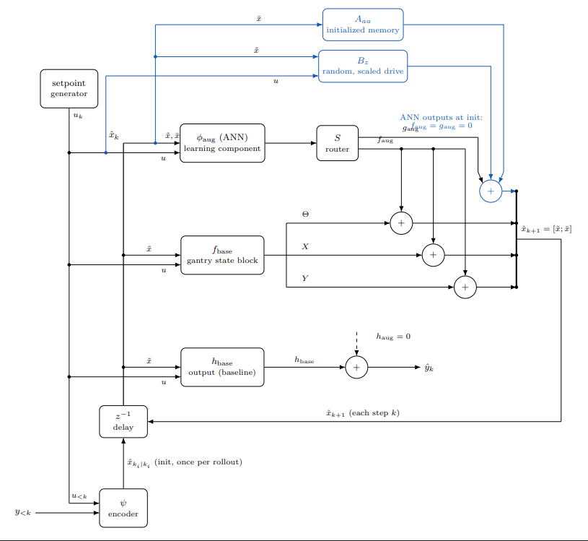

Slide 26
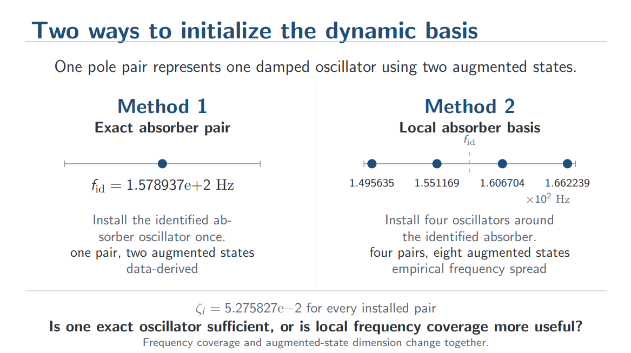

Slide 27
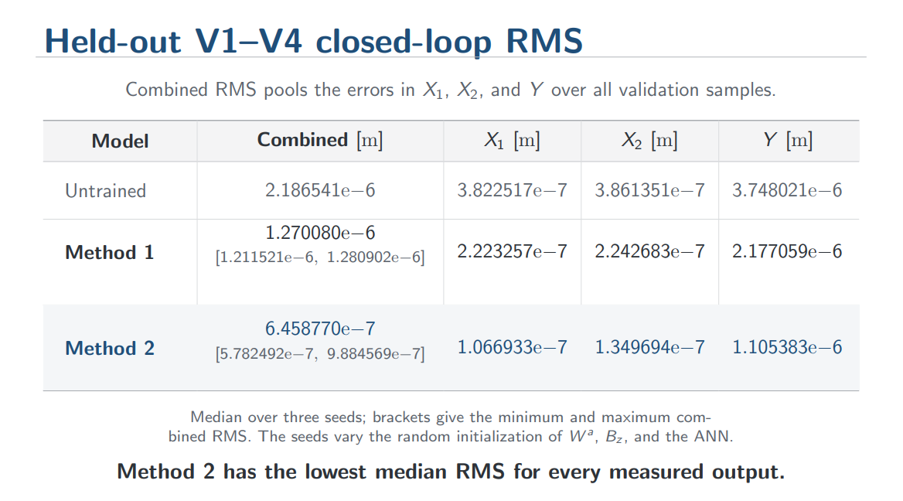

Slide 28
Training window issue?
Show the training nf rms over all training trajectories
What is the best possible range to reach? At least e-7?
E-8??
Should I increase the window instead?
Why move to pole placement augmented states?

Slide 29
Question
Currently making use of ARX any benefit for using BLA init of the residual?
  For the full-black box I’ll use a BLA, cleaner comparison.
Notes:
Shared-denominator multivariable ARX model from \(u(k)\) to \(r(k)\).

Slide 30
Question
Should the augmentation have a direct path to the output; h_aug unequal to 0?
  To keep the model better interpretable I prefer to keep h_aug = 0

Slide 31
Question
Kessels does add C / “extension” routing but else how useful is it? Because…

Slide 32
Question
Encoder transient…?

Slide 33
To do
Make augmented states train in a generalizable systematic approach
  After move to orthogonality
Update planning

Slide 34
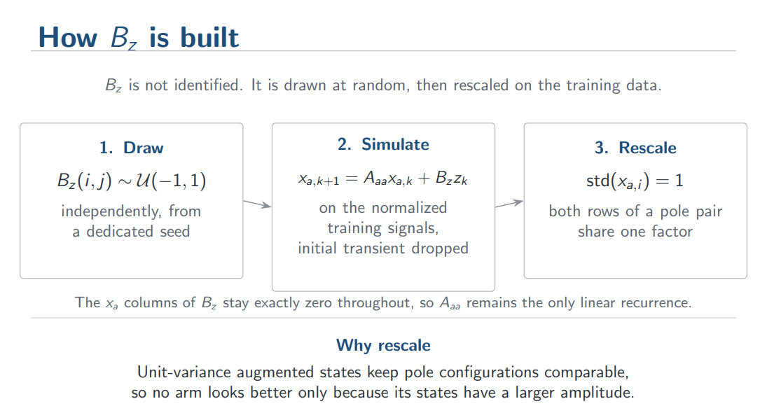

Slide 36
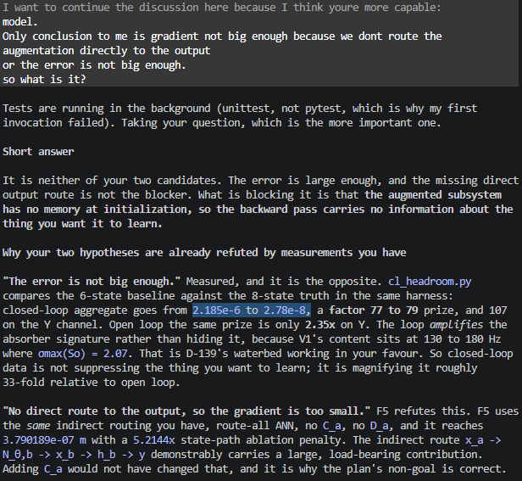
To do
Proof Jan’s routing doesn’t work for us
  Why? What is causing this
Implementation clean
  No heuristics
  No oracle data
  Not only for resonances
  Base it of literature
  Is the augmentation still nonlinear, or did we make it linear?
Full black box: BLA
Must I make the error larger between baseline and system like Jan??
  Not “enough gradient” now.
  But without noise the framework should be able to reach machine precision??
Closed-loop error te laag? Vergeleken met open-loop
Iniital offset probleem??
Should I add C_r to the output? I prefer without.
  No gradient path without. Show how it now works, same as jan.
  Keeps the model better interpreatable.
Explain current closed-loop training
Show what needs to be learned in frequency domain
Show trajectories learned.
Show A_aa + B_u is mostly linear, is this problematic?
Paar voorstellen zoals BLA van de init
  Polen laten zien en dan wat we met een BLA kunnen krijgen op stationary data
  BLA van de residual?
Closed-loop controller uitscrhijven toepassing
Figure achievable oracle and init validation trajectories X1 X2 Y also in logical cooridnates?
Een opsomming van dingen die niet werkten? Offset benomen? Laatste meeting slides kijken jan en maarten
Kijken figuur niet gebruikt asmpt, verbetering vooral in resonance region voor de rest correctie alleen slechter??
Kijken meeting slides wat ik wilde laten zien aan asmpt
Mention yesterday extension to 25 oktober → need to update planning
Increase training window length?
Controller effort for los
Transient problem
Discuss how gradient for augmented steas reaches, is this problematic?y
I think from the working results and the failures its quite clear which makes those models learn. What is that. and how do we make this BLA of the residual version work? should it be of the residual, i would say so. or do we not do of the residual but remove the poles that we already have?
So the adjoint dies in one or two samples, and the loss can only report on what the states do immediately. There is no gradient component that says "a resonance 76 samples long would help", because the model currently has no resonance for the loss to be sensitive to. You cannot get gradient information about a mode you do not yet have. That is the mechanism, and it is why raw gradient magnitude is a red herring: Adam largely rescales magnitude away, but it cannot manufacture information that is not in the gradient.

Slide 37
Outline training problems augmented states
Problem | What happens | Evidence
Zero-output initialization delays the gradient | On the first backward pass, only the zero final/readout layer receives gradient. The augmented writer, \(A_a\), \(B_a\), and encoder rows can initially receive exactly zero gradient. | Measured delayed-gradient sequence.
Jan-style all-zero augmented writer has an extremely weak bootstrap | It is not mathematically permanently dead, but the delayed augmented gradient was only about \(1.34\times10^{-10}\). | Measured two-step audit.
No direct drive \(B_a\) in the LRU construction | The recurrence exists, but the input cannot reliably excite it. | F2: \(1.340\times10^{-6}\), far above the successful \(3.79\times10^{-7}\).
No useful recurrence/memory basis | An ANN-written latent state without the installed LRU did not reproduce the successful result. | F1: \(1.398\times10^{-6}\).
Wrong frequency support | States can be nonzero and receive gradients while representing the wrong dynamics. | F4a/F4c: approximately \(1.39\times10^{-6}\).
Arbitrary memory/radius support | Broad random memory is not enough; its time constants must be relevant. | F4b: \(1.253\times10^{-6}\).
Only one accurate pole pair | The 157.9 Hz pair was estimated accurately, but the two-state model plateaued around \(1.2\times10^{-6}\). | ARX and residual-BLA agree to five digits but obtain the same plateau.
Pole-only BLA initialization | Only \(A_r\) was identified. \(B_a\) was random/scaled and the physical correction readout started at zero, so the initialized input-output correction was identically zero. | Explicitly admitted in BLA results.
Random augmented encoder rows | Random \(W^a\) made performance worse than zero/frozen augmented encoder rows. | F3a: \(8.09\times10^{-7}\), versus F3b/F3c around \(3.83\times10^{-7}\).
Physical correction can bypass \(x_a\) | The ordinary ANN rows can reduce the loss without using augmented memory. This gives optimization a shortcut and can leave \(x_a\) nonessential. | J1 learned most short-window improvement through physical rows; augmented-state ablation was needed to reveal its smaller contribution.
Short-window versus 12-second objective mismatch | Good windowed loss does not ensure stable or accurate 12-second free simulation. This occurs even in the full black-box model, so it is not solely an augmentation bug. | Several models improved locally and later degraded or failed in long free runs.
Poor recurrent credit over the required memory | In the plain J1 recurrence, exact augmented-state sensitivity at lag 76 was only \(3.31\times10^{-4}\) relative to lag 1. | Dense lag-gradient diagnostic.
Incomplete or biased residual interpretation | An inaccurate baseline makes the residual contain parameter errors, omitted dynamics, nonlinear effects and noise simultaneously. The ANN has no unique reason to separate them. | Fundamental grey-box identifiability issue.

Slide 38
Show augmented states not learning

Slide 40
That is the reference to every digit. So the 2.77e-05 deviation you saw on the server is not a broken build; it is a difference between my scoring path (augtrain.validation_metrics) and the harness's own. My encoder hypothesis was probably wrong. In the 78465 logs, look for that same Initial Validation sim-RMS line: if it reads 2.186601103417735e-06, baseline equality holds and my printed gate is just measuring something slightly different

Slide 41
Arm 2 beats the "oracle" because the planted model optimises one-step error while arm 2 optimises the rollout, and those have different minima. So do not present C2 as a ceiling — the verdicts are explicit about this and it would be the easiest thing in this whole set to get wrong in front of Toth.

Slide 42
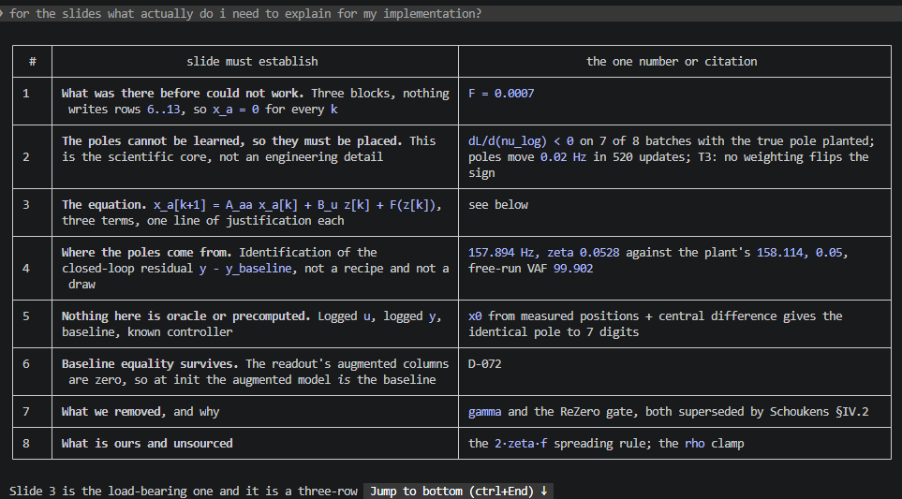

Slide 43
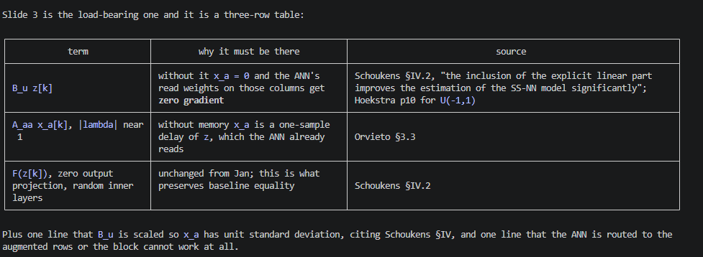

Slide 44
Augmented states not learning
You replaced the correction network with a wrapper that adds a fixed linear resonant recurrence on the augmented rows only, driven by a live random input map, with the pole frequencies taken from an identification of the closed-loop residual the baseline leaves.
Problem:

Slide 45
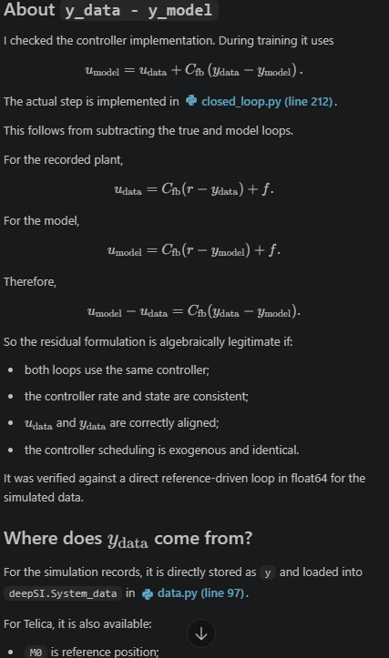
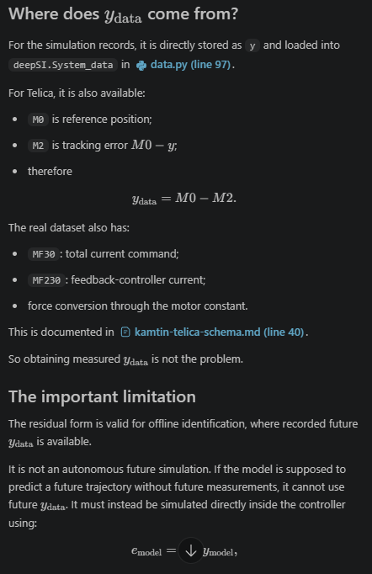

Slide 46
Cant create BLA from this??
So every T/V record contains exactly one period of one realization. And gtd_build_records.m:12 assigns seed = 100*track_id + index, an independent realization per record, while the records also differ in operating point, band and trajectory type. They are not replicates of a fixed excitation class.That means, on existing data:┌─────────────────────────┬────────────────────────────────────┬────────────────────────────────────────┐│ BLA ingredient │ requires │ on disk │├─────────────────────────┼────────────────────────────────────┼────────────────────────────────────────┤│ noise variance │ P >= 2 periods, same realization │ P = 1 │├─────────────────────────┼────────────────────────────────────┼────────────────────────────────────────┤│ nonlinear distortion │ M >= 2 realizations, everything │ realizations exist but nothing else is ││ variance │ else fixed │ held fixed │├─────────────────────────┼────────────────────────────────────┼────────────────────────────────────────┤│ FRF at excited lines │ periodic steady state │ one period, transient not separable │└─────────────────────────┴────────────────────────────────────┴────────────────────────────────────────┘No estimator can recover a BLA from that. So every attempt to build one against the existing dataset must degenerate into whatever survives when you delete the impossible parts, which is a parametric fit on ordinary records. That is probe_residual_bla.py. It then inherits the name, and the name propagates. The naming failure is downstream of this; the data is the cause.

Slide 47
C:\Users\20203253\OneDrive - TU Eindhoven\Graduation Project\Baseline FP model\Baseline-LPV-Augmentation\literature\augmented-states

Slide 48
Need to extend to other dynamics than only resonator
Does the approach generalise? The approach yes, this implementation not quite. Separate the two:- The recipe is fully general: a fixed linear basis with memory, followed by a trained static readout. That is the rational orthonormal basis function idea, and it is the same structure as Orvieto's LRU. Nothing in it is specific to resonances.- The restriction is that A_aa is built only from 2x2 rotation blocks. Real dynamics such as friction lag, thermal drift, or amplifier roll-off need real poles, and the current code cannot install one.The fix is small. A_aa is already block-diagonal, so a real pole is just a 1x1 block with ρ ∈ (0,1), θ = 0. It needs _modal_pairs to stop discarding real roots and AugmentedDynamics to accept odd block counts. Orvieto's own formulation is diagonal complex, which covers both cases in one parameterisation, so there is no citation problem either.

Slide 49
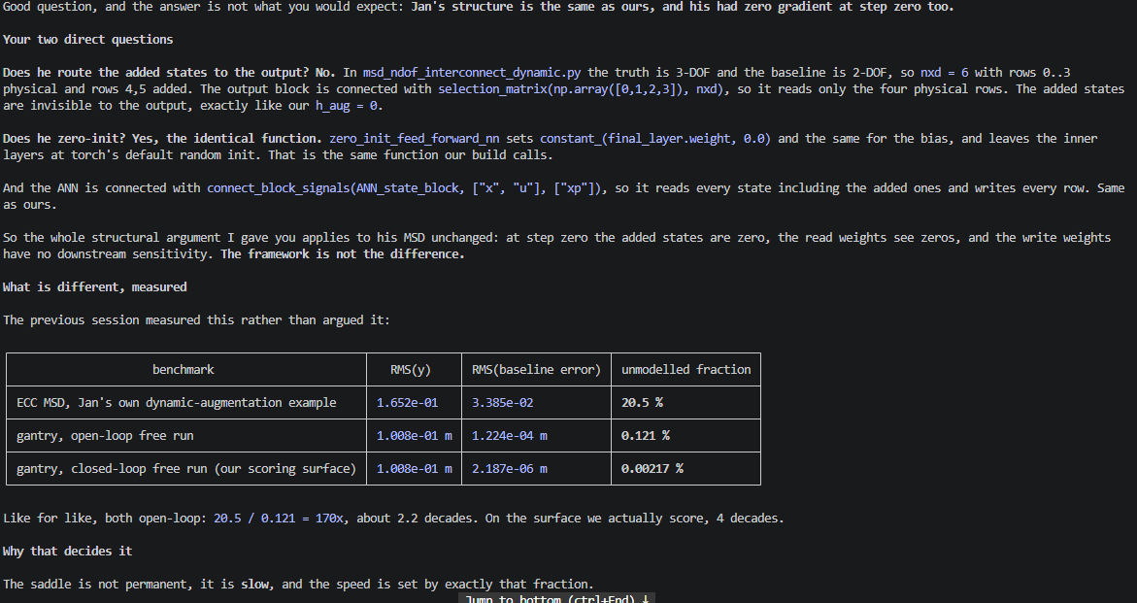
Why did jan’s routing learn?
can you explain to me why our augmented states didnt learn anything but jan's did? does he route the augmented states to the output, or how did his method GET a gradient? he also zero init right, so i dont get the difference.
but why cant we make it work like jan does?Short answer: we did try, and the measurements say it is not that it would be slow, it is that the objective points the wrong way.
1. The states stay dead. Uninformed, zero-init, encoder-excited, exactly Jan's structure: ablation 1.0002x, F = 0.0007. After 520 updates the added states carried 0.07 % of the improvement. Everything came through the physical rows.2. The pole does not move toward the mode. This is the one that closes the door. Plant the true mode by hand, so the model starts at the answer, and then measure the gradient on the pole radius. dL/d(nu_log) < 0 on 7 of 8 disjoint batches, monotone over 150 steps. Negative there means the objective is pushing the radius down, away from the resonance, while sitting on the correct solution.

Slide 50
Is the readout actually using x_a nonlinearly? Unmeasured, and cheap to settle: regress F(z) against its best linear approximation in z over a rollout and report the residual fraction. If F is essentially linear, the entire augmentation is a linear system in disguise and your objection is fully correct. If it is genuinely nonlinear, you have a nonlinear readout over a learned memory basis, which is a legitimate and much richer class. Minutes, on a checkpoint we now have.The structural limit that will bite on Telica. Because A_aa is linear and fixed and F is static, the memory itself cannot be state-dependent. That is fine for friction and thermal effects, which are static nonlinearities over a memory the basis can supply. It is not fine for hysteresis, where the memory depends on the amplitude history. Bouc-Wen is exactly that case and this architecture would struggle with it. That is a concrete, checkable claim and it is the honest scope limit.The conditioning risk you are pointing at. F must compete with terms of magnitude ~3 starting from zero output. That is D-426's nine-decade problem in a new form, and D-426 already measured that per-row output scaling fixes it, 1-R² from 0.98 to 9.6e-05. If a nonlinear residual is present and F still does not write those rows, output scaling is the first thing to try.

Slide 51
Cleaner implementation??
Yes, \(x_a\) being alive would provide a gradient—but only after the physical correction head has taken one optimizer step.
Write the shared hidden representation as
\[ \phi_k=\phi(x_b[k],x_a[k],u[k];\eta), \]
with separate final-layer rows
\[ F_b=W_b\phi_k,\qquad F_a=W_a\phi_k. \]
Initialize
\[ W_b=0,\qquad W_a\sim\text{Xavier}. \]
On the first backward pass:
\[ \frac{\partial L}{\partial W_b} = \sum_k \lambda_{b,k+1}\phi_k^\top \neq 0, \]
because the physical prediction error trains the physical output rows.
But
\[ \frac{\partial L}{\partial W_a}=0, \qquad \frac{\partial L}{\partial \eta}=0 \]
initially, because \(W_b=0\) means that changing \(x_a\) cannot yet change \(x_b\) or \(y\).
After the first optimizer step, \(W_b\neq0\). Then
\[ \frac{\partial L}{\partial x_a} \propto W_b\frac{\partial\phi}{\partial x_a} \]
is generally nonzero, so the next backward pass gives gradient to \(W_a\) and the shared hidden layers.
Thus:
first backward: physical head only;
second backward: augmented writer and shared network become trainable.
That is a genuine one-update delay and much cleaner than Jan’s original one-sample-at-the-start-of-each-window bootstrap.
A nonlinear replacement for A_aa + B_u
Yes. In fact, J1 already is the unconstrained nonlinear version:
\[ x_a[k+1]=F_a(x_b[k],x_a[k],u[k]). \]
A more structured version would be a leaky nonlinear recurrent cell:
\[ x_a[k+1] = (1-\alpha)x_a[k] + \alpha\tanh\!\left( W_xx_a[k]+W_z \begin{bmatrix}x_b[k]\\u[k]\end{bmatrix} +b \right), \]
with \(0<\alpha<1\).
Here:
\(W_xx_a\) is the nonlinear analogue of A_aa x_a;
\(W_z[x_b,u]\) is the nonlinear analogue of B_u z;
the input path is live at initialization;
no poles, damping ratios or spread widths need to be chosen;
everything remains trainable.
If stability matters, constrain \(\|W_x\|<1\), for example through spectral normalization. This gives a contractive nonlinear reservoir instead of the pole-placed linear reservoir.
I would still test the simpler J1 first. A contractive recurrent cell adds another design decision before we know whether ordinary row-selective initialization already works.
Assessment of the other session’s argument
It is mostly right, with several qualifications.
Baseline equality
Structurally, it is correct:
\[ F_b=0 \quad\Longrightarrow\quad x_b[k+1]=f_b(x_b[k],u[k]) \]
even while \(x_a\) evolves. Because the output reads only \(x_b\), \(y\) remains the baseline output.
I would not promise “bit-exact D-072” without running the gate. Structurally the physical equations are identical, but comparisons against a separately constructed baseline can still differ through encoder dimensions, normalization and floating-point execution. The current i–iii gate reports relative deviation 2.77e-05, not literal bit equality. The proper statement is:
Row-selective initialization preserves baseline equality by construction; D-072 must confirm the numerical tolerance.
The one-update gradient delay
Agreed. This is the key mechanism, and it is substantially better than Jan’s original bootstrap.
If J1 works, the pole-placement problem disappears
Agreed, and this is the largest potential benefit. Successful J1 would remove:
2ζf;
the number of pole pairs;
pole identification;
real-versus-complex pole handling;
LPV-OBF justification;
the question of whether poles train.
That would produce a much cleaner contribution: an initialization change that makes nonlinear latent dynamics trainable while retaining the baseline model at initialization.
“The idle augmented-row ANN is not a failure”
The other session is right to correct this.
For the gantry residual, A_aa + B_u already supplies an appropriate linear basis. If the residual is effectively linear, the optimal behaviour may indeed be:
linear augmented dynamics;
nonlinear or approximately linear learned readout;
negligible nonlinear correction to the augmented rows.
Therefore, the small \(F_a\) term does not mean the AB model failed. It means AB does not demonstrate that the ANN learned its own augmented recurrence.
Those are different claims.
Should the test run only on the nonlinear MSD?
The MSD is an excellent cheap first gate, but it cannot fully replace the gantry experiment.
A large 118% residual gives the bootstrap an easy gradient signal. It answers:
Can this initialization train nonlinear augmented dynamics when the signal is strong?
It does not answer:
Does it fix our original weak-residual gantry problem?
The right sequence is:
Let the current L and N reference runs finish.
Run the initialization variants on the cheap MSD linear/nonlinear pair.
If J1 fails there, stop; it is not worth an 11-hour gantry run.
If J1 works, run at least J0 versus J1 once on the gantry.
That preserves the value of the cheap screening experiment without extrapolating from a 118% residual to a 0.121% residual.
What the eight MSD runs would and would not prove
The proposed J0/J1/J2/AB × linear/nonlinear design is good, but final RMS alone does not prove that \(F_a\) learned.
J1 might behave as a random nonlinear reservoir:
\(F_a\) generates useful but nearly fixed random dynamics;
only \(F_b\) learns to read them.
That is still useful, but it is not “the ANN learned its augmented dynamics.”
The experiment should therefore record:
gradient of physical final rows;
gradient of augmented final rows;
gradient of shared hidden layers;
measurements before update 1 and before update 2;
augmented-state RMS, peak and effective rank;
hidden tanh saturation fraction;
final augmented-state ablation.
The existing x_aug summary records RMS, peak and rank, but not hidden-layer saturation. That metric must be added separately.
Ideally, include a frozen-writer control:
\[ W_a,\ \text{writer parameters frozen after initialization}. \]
Then:
J1 beating frozen-J1 shows that learning the state generator matters;
equal performance means J1 is functioning as a fixed random reservoir;
both beating J0 still shows that live augmented states solve the bootstrap problem.
On recurrence stability
The other session is correct that J1’s state values are bounded for finite weights because the final hidden activations are tanh-bounded. But bounded values do not guarantee good recurrent behaviour.
J1 can still have:
saturated hidden activations;
chaotic sensitivity;
exploding or vanishing backpropagated gradients;
poor long-term memory.
So state RMS and peak are necessary but insufficient. I would also log
\[ \left\| \frac{\partial F_a}{\partial x_a} \right\|_2 \]
along the rollout, or at minimum the hidden saturation fraction. A contractive nonlinear cell becomes worth considering only if unconstrained J1 exhibits problems here.
Recommended experiment
Use the current MSD run as the AB reference and add:
Run these on both linear and cubic MSD residuals. Treat J2 as an optimization ceiling, not a clean method candidate, because it abandons baseline equality.
My overall view is: the other session’s proposal is directionally correct. The two additions I consider essential are the frozen-writer control and one later gantry J1 run if the MSD gate succeeds. Without those, we could mistake “a random reservoir is readable on a large residual” for “we fixed trainable augmented dynamics on our original problem.”
Arm | Physical rows | Augmented rows | Recurrence
J0 | zero | zero | ANN-only, initially dead after \(x_a[0]\)
J1 | zero | Xavier | live nonlinear recurrence
J1-frozen | zero | Xavier, frozen | fixed random-reservoir control
J2 | Xavier | Xavier | ordinary ANN initialization; loses baseline equality
AB | zero ANN | zero ANN plus A_aa+B_u | current linear basis

Slide 52
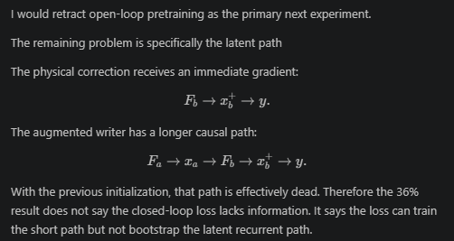
With the previous initialization, that path is effectively dead. Therefore the 36% result does not say the closed-loop loss lacks information. It says the loss can train the short path but not bootstrap the latent recurrent path.
Can we replace the installed \(A_{aa}+B_u\) latent trajectory with a trainable, mechanically structured writer while retaining the successful closed-loop optimization geometry?

Slide 53
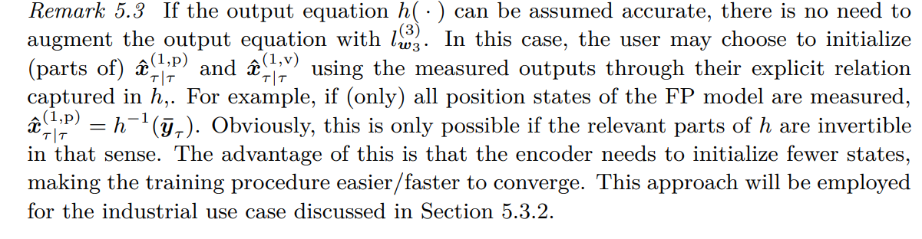
Kessels, Citeable
pp. 151–153, especially Eq. (5.4) and Fig. 5.2: the core architecture. Page 151 defines the extended position–velocity pair, the learned velocity writer \(l_{w_2}^{(2)}\), and the separate learned correction \(l_{w_1}^{(1)}\) to the physical acceleration. Page 152 explicitly says the writer is a feedforward NN used recurrently and discusses scaling; page 153 shows that the output map can remain separate.
pp. 154–159, especially Eqs. (5.12)–(5.13) and Fig. 5.4: how it is trained. These pages cover truncated windows, the encoder, differentiated closed-loop rollout, vanishing/exploding gradients, and near-zero initialization for closed-loop stability.
p. 157, Remark 5.3: directly supports our decision not to augment the measured-position output when the physical output equation is trusted.
pp. 170–174: the industrial closed-loop implementation. It initializes measured physical positions/velocities directly, makes the encoder estimate only extended states, and reports that extra state pairs capture missing modes.
p. 174, Remark 5.6: especially relevant to us—the attempted open-loop identification from closed-loop data was unsuccessful.
pp. 175–180, particularly Fig. 5.14 and Tables 5.5–5.7: evidence that extra state pairs reduce errors in specific frequency bands and generalize across references/controllers.

Slide 54
▎ The residual you are chasing is so small (0.12 % open loop, normalised loss 1.8e-10) that anything reaching the loss only through a second-order path produces gradients beneath the optimizer's numerical floor. The augmented states are no longer failing for a structural reason. They are failing because the optimizer cannot act on gradients that small.

Slide 55
what is currently the issue with the augmented states not learning. the error is too small? the controller hides the plant error. we dont get a clear signal and gradient because we dont route through the output, and it is not seen in the loss?
what is currently the issue with the augmented states not learning. the error is too small? the controller hides the plant error. we dont get a clear signal and gradient because we dont route through the output, and it is not seen in the loss?──────────────────────────────────────────────── 1 new message ────────────────────────────────────────────────Taking your three hypotheses in turn, against what has actually been measured.1. "The error is too small" — was true, is now settledThis was exactly right, and it was the eps failure. With eps=1e-16 Adam is scale-invariant again, so the absolute size of the residual no longer determines whether parameters move. Your re-run proved that: 1.22e-8 to 5.56e-3, 457,000x.What remains is not absolute smallness but relative smallness, which is a different problem and appears under hypothesis 3.2. "The controller hides the plant error" — measured false in the band that mattersThis is the intuitive one and the data contradicts it. The loop suppresses low-frequency motion mismatch by 47x to 2800x, but it amplifies the absorber band: sigma_max(S_o) = 1.81 near 157.89 Hz. And 83 % of the closed-loop residual power sits in the absorber band.The open-loop residual is 1.224e-4 against the closed-loop 2.187e-6, a factor 56, and almost all of that 56x is the low-frequency mismatch the loop removes and you do not need. So the loop concentrates the target signal rather than hiding it. Training open loop would give you a 56x larger error that is mostly about the wrong part of the spectrum, and (per the arithmetic from before) still would not have cleared the eps floor.The controller is not your problem. It is doing you a favour on the one mode you care about.3. "No clear signal because we don't route through the output" — half right, and the half that is right is the current issueThe route exists and carries gradient. x_a -> coupling -> physical velocity rows -> positions -> y. Verified: coupling-output gradient 8.06e-9 on update 1, writer gradient non-zero on update 2, writer parameters now move by 5.56e-3. Ablating the latent path changes the loss. So it is seen in the loss. And not routing x_a directly to h is deliberate and Kessels-faithful (his Remark 5.3), so that part should not change.But the route is weak in a specific way, and that is the real answer to your question. Not weak in gradient magnitude any more. Weak in discrimination: the objective cannot tell a good latent writer from a random one.That is measured, and not only by your last run:
Taking your three hypotheses in turn, against what has actually been measured.1. "The error is too small" — was true, is now settledThis was exactly right, and it was the eps failure. With eps=1e-16 Adam is scale-invariant again, so the absolute size of the residual no longer determines whether parameters move. Your re-run proved that: 1.22e-8 to 5.56e-3, 457,000x.
And the objective has already been measured directly. RESULT-plateau.md: at nf = 400 the training loss ranks a correct augmentation only 1.25x better than the one training actually finds, because 88 % of a correct model's window loss is startup transient it cannot fix. Not scoring the first 100 samples raises that to 3.40x. So the loss is nearly blind to whether the dynamics are right.

Slide 56
The augmented states are live, observable through the physical dynamics, and optimizable. The remaining measured problem is that the present 400-sample closed-loop objective gives very little advantage to learning their recurrence over retaining a frozen random recurrence. Startup-transient dominance is the leading explanation, while reservoir adequacy and defective latent-state scaling remain competing explanations.
This is the strongest diagnosis so far, but it overstates what has been proven.
What I agree with:
The absolute gradient magnitude is no longer the immediate issue. With \(\epsilon=10^{-16}\), the writer moved \(5.56\times10^{-3}\).
Not routing \(x_a\) directly to \(h\) is not the problem. The valid route is\[ x_a\rightarrow\text{physical dynamics}\rightarrow x_b\rightarrow y, \]and measured gradients confirm it works.
The current loss weakly distinguishes the trainable writer from a frozen reservoir: only a \(0.0198\%\) loss difference after 50 updates.
Startup-transient dominance is a credible explanation. If 88% of even the correct model’s window loss is unrelated to the dynamics we want to distinguish, gradient descent receives a poorly focused objective.
What is overstated:
“The controller is not the problem”
The controller does not hide the 158 Hz mode: the measured sensitivity and residual spectrum support that. But it suppresses other plant errors substantially. Since your goal is an accurate plant across the relevant bandwidth—not merely the absorber mode—the controller still changes which plant errors the objective emphasizes.
The accurate statement is:
Closed-loop training exposes the missing 158 Hz mode well, but reweights the overall open-loop plant error.
“Gradient descent has nothing to descend toward”
A 1.25× objective difference is still a difference. The issue is weak discrimination and conditioning, not absence of an optimum. Moreover, comparing the losses of two completed models does not prove that the local gradient from the current initialization points reliably toward the correct one.
“Four parameterizations all prove the dynamics need not learn”
Arm iii and the LRU arm apparently used default Adam epsilon, so their dynamics-parameter movement is confounded. Only the corrected Kessels writer test establishes that the writer can move yet adds little over 50 updates.
The frozen-writer tie has multiple explanations
It could mean:
startup transient dominates the objective;
the missing dynamics are sufficiently linear that random reservoir features plus a trained coupling are enough;
50 updates are insufficient;
the current \(q/v\) scaling provides almost no useful mechanical memory;
zero latent initialization hurts every window.
Burn-in separates some of these, but not all. If learned and frozen remain tied after burn-in, that does not uniquely prove that training the recurrence is unnecessary.
My short formulation would be:
The augmented states are live, observable through the physical dynamics, and optimizable. The remaining measured problem is that the present 400-sample closed-loop objective gives very little advantage to learning their recurrence over retaining a frozen random recurrence. Startup-transient dominance is the leading explanation, while reservoir adequacy and defective latent-state scaling remain competing explanations.
The proposed burn-in test is good. However, I would not reapply the old framework patch for a six-minute diagnostic. Add burn-in directly to the smoke-test loss while still rolling out all 400 samples:
\[ L=\frac{1}{300}\sum_{k=100}^{399}\lVert y_k-\hat y_k\rVert^2. \]
Then repeat learned versus frozen with \(\epsilon=10^{-16}\). It remains a one-variable, approximately six-minute experiment and avoids changing the production training framework.

Slide 57
And the objective has already been measured directly. RESULT-plateau.md: at nf = 400 the training loss ranks a correct augmentation only 1.25x better than the one training actually finds, because 88 % of a correct model's window loss is startup transient it cannot fix. Not scoring the first 100 samples raises that to 3.40x. So the loss is nearly blind to whether the dynamics are right.
The augmented states are live, receive gradient, and their writer now trains. The remaining problem is that the loss barely distinguishes a correct latent dynamic from a random one: it ranks a known-correct augmentation only 1.25x above what training finds. So gradient descent has nothing to descend toward, and a trained writer ties a frozen random one.

Slide 58
Initial condition / transient problem

Slide 59
Residual-FRF-based, BLA-informed pole initialization, conditional on the simulation baseline and excitation.
Not:
The identified BLA was installed into the augmentation.

